Slide 1

Fifth session
Introduction to machine learning

Slide 2

Session outline
Go through homework
SVM
Reinforcement learning
LSTM NN in Keras

Slide 3
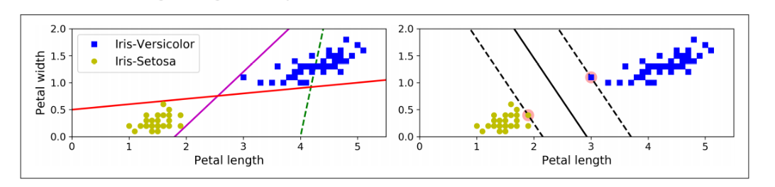
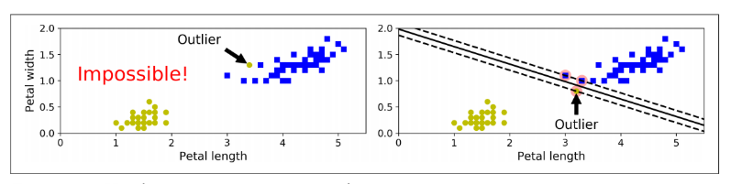
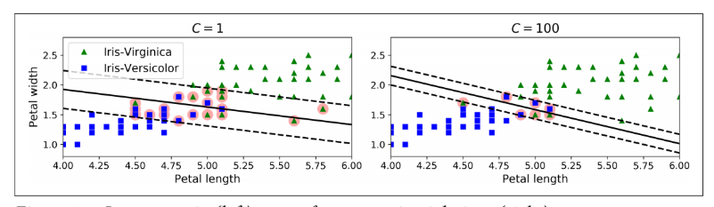
Support-vector machine
Sepearates classes while staying as far as possible from the closest training instances in each category
Hard or soft margin
Can be used for linear on non-linear data
For large values of C, the optimization will choose a smaller-margin hyperplane if that hyperplane does a better job of getting all the training points classified correctly. Conversely, a very small value of C will cause the optimizer to look for a larger-margin separating hyperplane, even if that hyperplane misclassifies more points

Slide 4
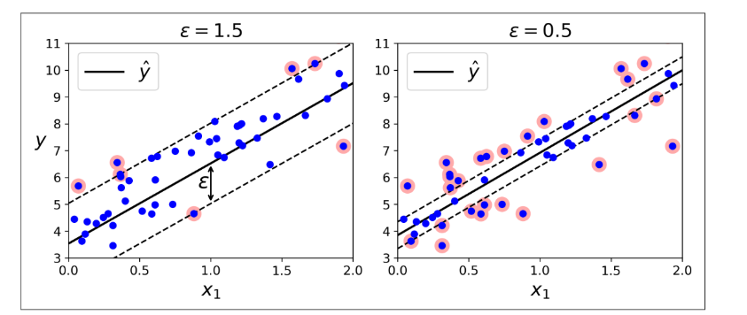
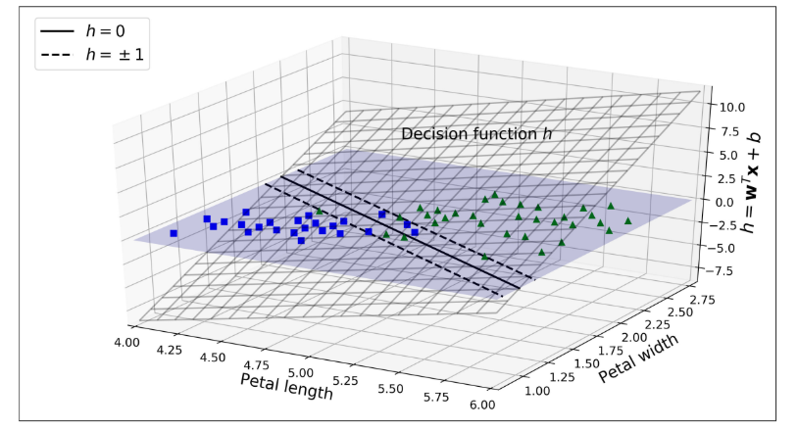
SVM
Can also be used for linear or non-linear regression, where the goal is to fit a street with the data points on it
.

Slide 5
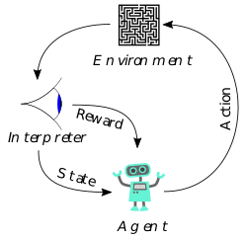
Reinforcement learning
https://www.youtube.com/watch?v=gn4nRCC9TwQ
A “reward” is defined
The program works to optimise the reward

Slide 6
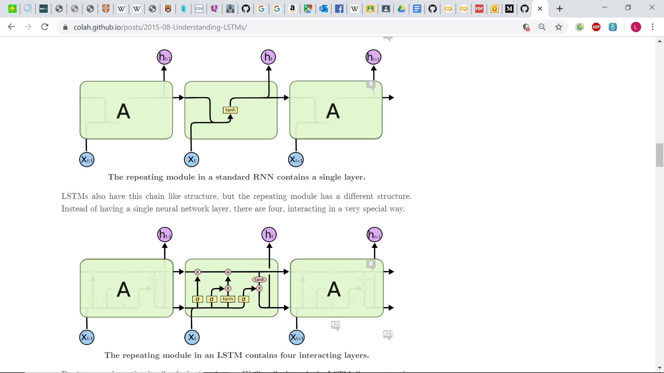
LSTM
Often used in conjunction with NN
Particularly when context is important, such as for time series or natural language

